Slide 1
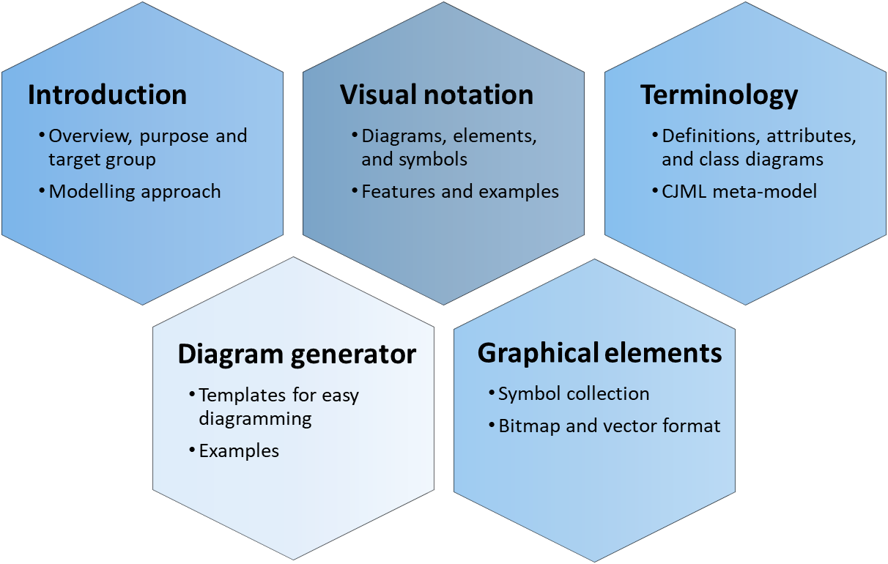
Introduction CJML - Customer Journey Modelling Language
Version 1.1
SINTEF Digital | Software and service innovation
March 2021
Copyright © 2021 SINTEF

Slide 2
Overview of CJML resources
Introduction
Overview, purpose and target group
Modelling approach
Visual notation
Diagrams, elements, and symbols
Features and examples
Terminology
Definitions, attributes, and class diagrams
CJML meta-model
The CJML material consists of several documents that are to be seen in connection to each other. The material can be used separately, but we recommend to start with Introduction and overview.
Diagram generator
Templates for easy diagramming
Examples
Graphical elements
Symbol collection
Bitmap and vector format
All the CJML resources can be found here: www.sintef.no/cjml

Slide 3
Content
Readers guide
Who can use this material?
Additional resources
Introducing CJML
Key facts
Target group
Development and origin
Theoretical foundation and modelling approach
Planned and actual journeys
Journey types and examples
Touchpoint typology
Delineation of steps
A quick tour of CJML
Diagram types and examples
Comparison of diagram types
Customer/User experience
From scenario to journey
Example - alarm service
From business scenario to planned journey
From user scenario to actual journey

Slide 4
Who can use this material?
CJML v1.1 by SINTEF Digital is licensed under a Creative Commons Attribution-ShareAlike 4.0 International License.
Anyone can use, copy, and transform the material in any medium or format – for any purpose – under the following terms:
Attribution: You must give appropriate credit, provide a link to the license, and indicate if changes were made
ShareAlike: If you remix, transform, or build upon the material, you must distribute your contributions under the same license as the original.
Guidance on how to give appropriate credit can be found here:
https://creativecommons.org/use-remix/
https://wiki.creativecommons.org/wiki/Best_practices_for_attribution

Slide 5
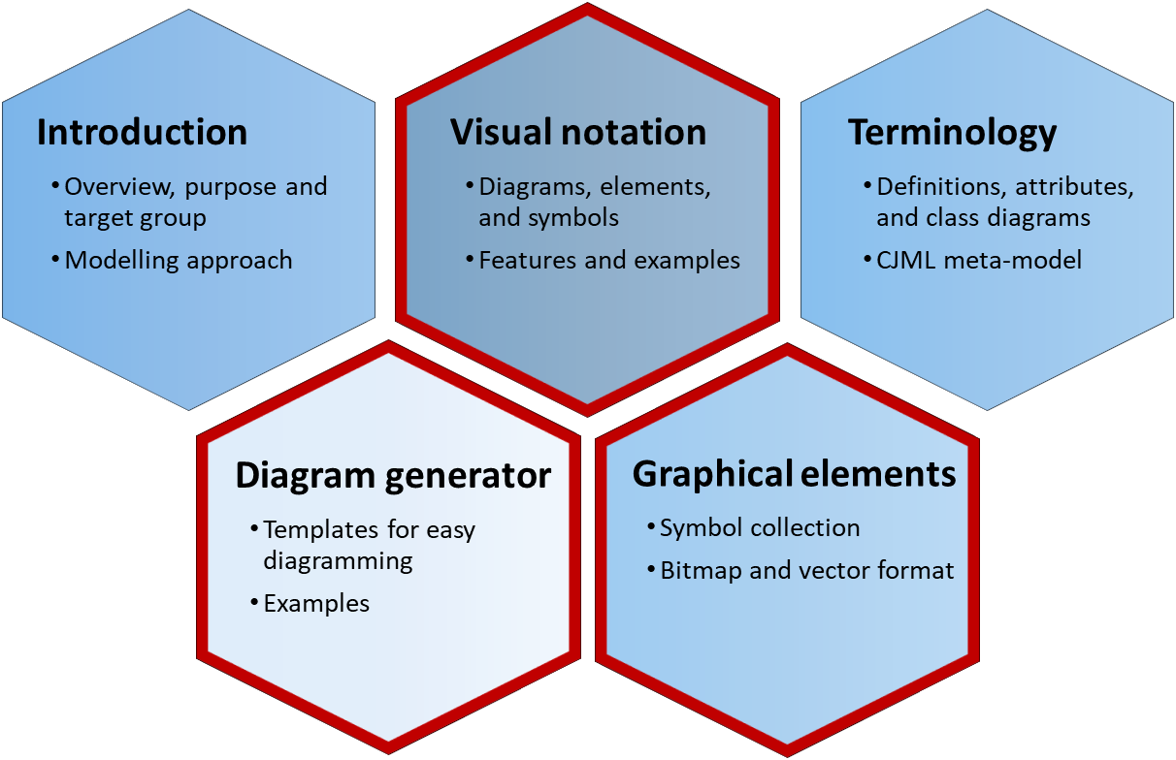
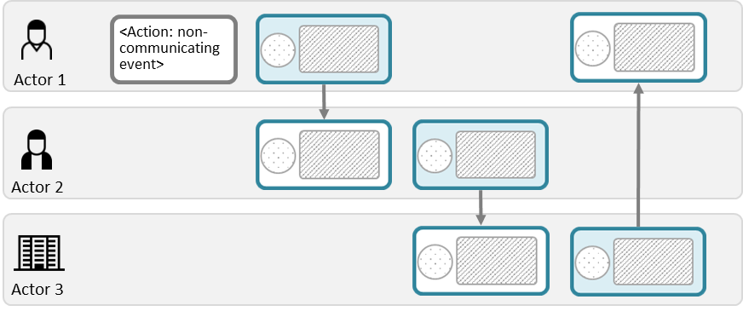
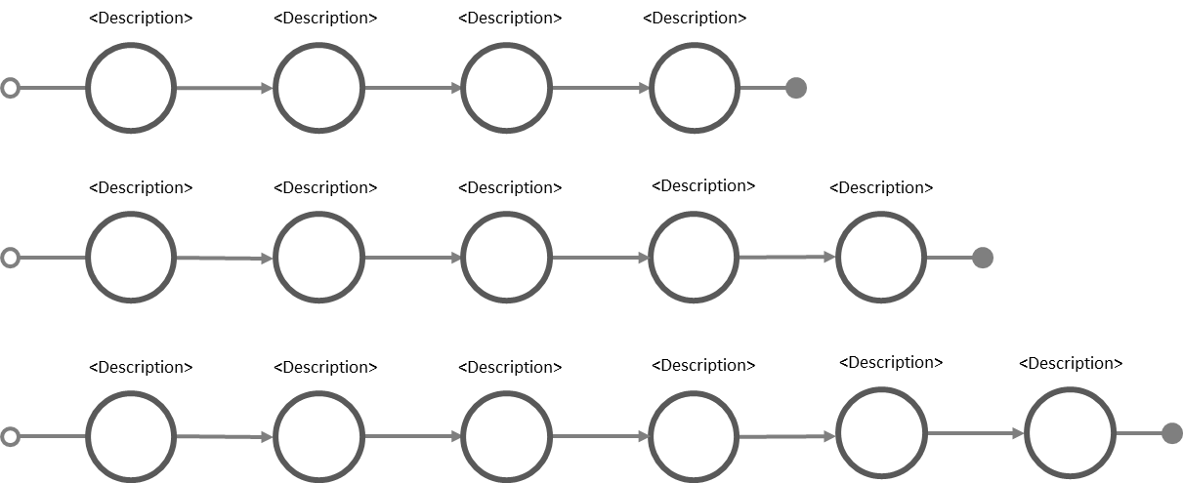
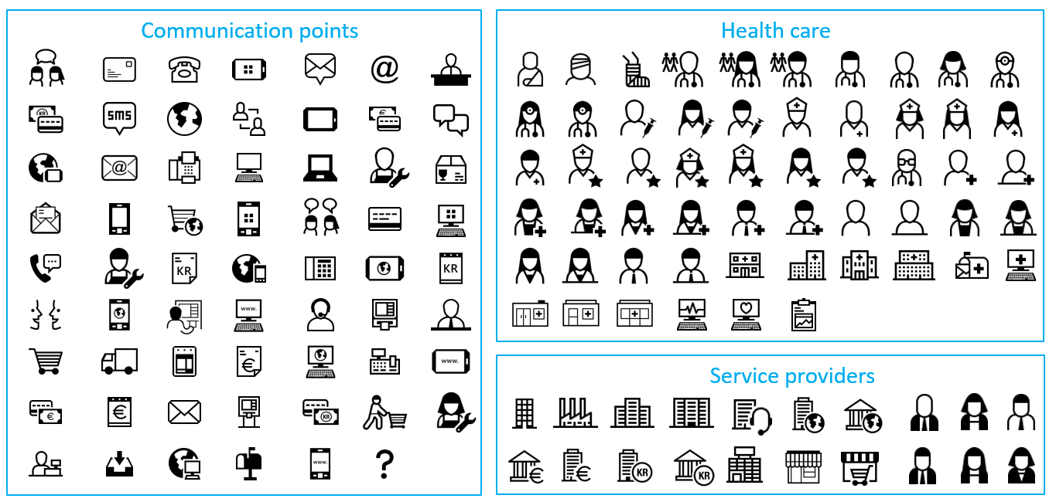
Additional CJML resources
For more information and publications based on CJML, please visit the web resource page: www.sintef.no/cjml
For help creating diagrams:
Try our Diagram generator
Alternatively, simply copy-paste elements from the Visual notation slides and modify for your own use.
You can also download graphical elements in bitmap format (png) or vector format (svg)
The former project site contains blog articles and stencils for Visio and Omnigraffle, see www.visualproject.org (not updated after 2016)
These modules contain support for making diagrams
Templates
Symbol gallery

Slide 6
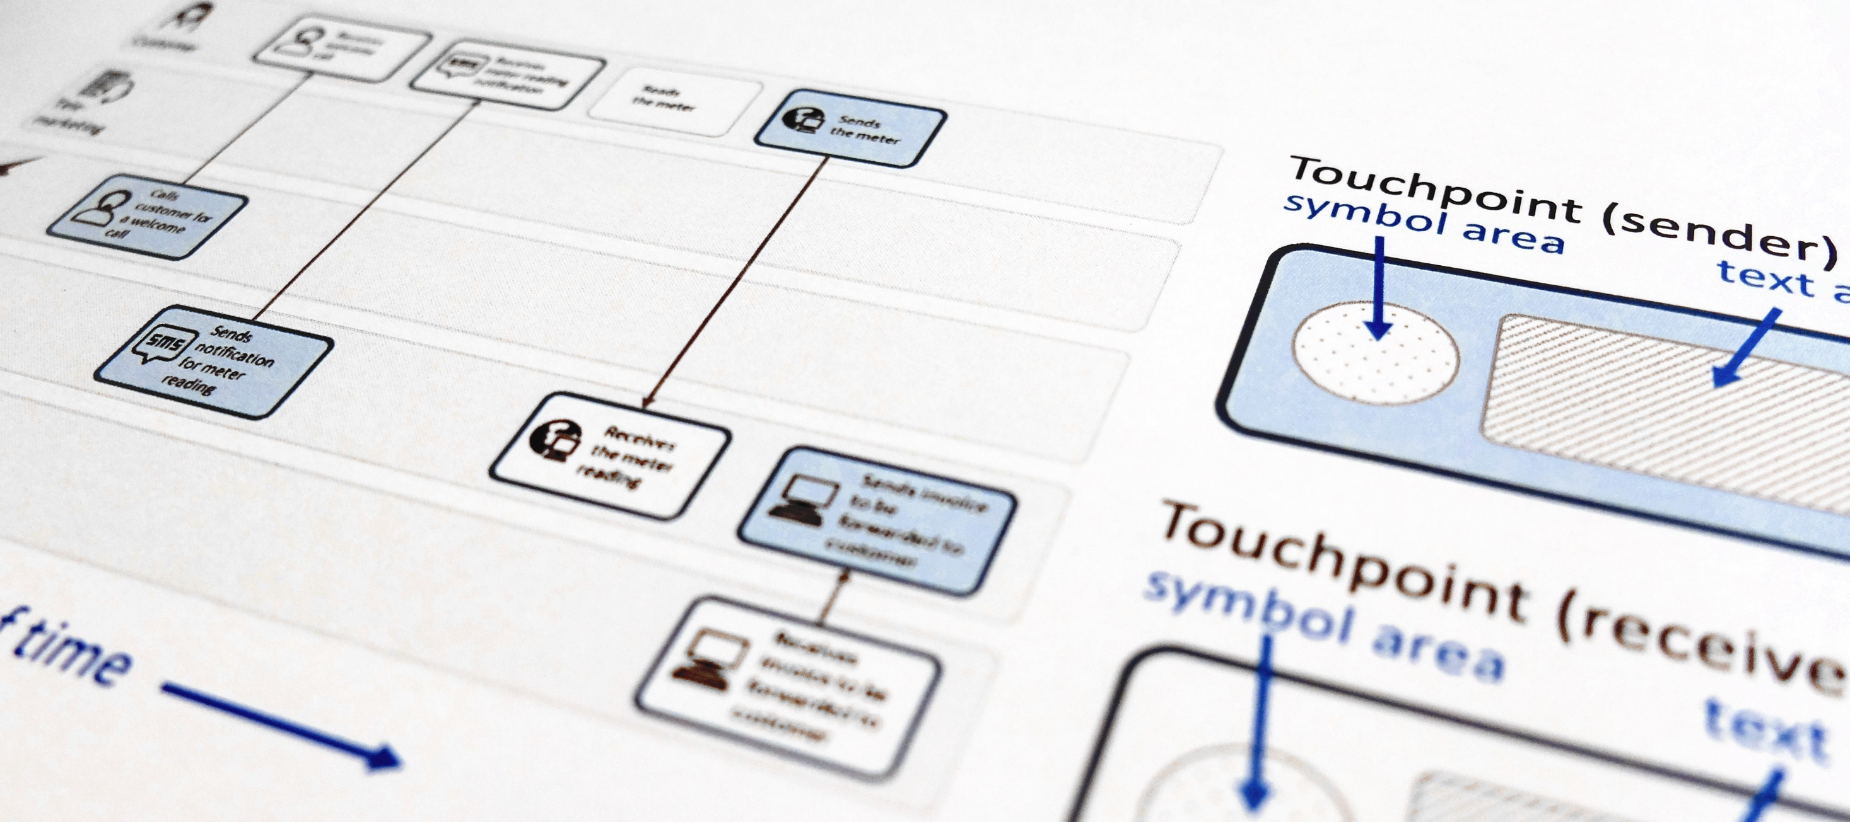
CJML - Customer Journey Modelling Language
CJML is a visual language dedicated to modelling of customer journeys, human behaviour and digital service processes
Customer journey
User journey
Employee journey
Patient journey
Citizen journey

Slide 7
Introducing CJML
Key facts
Target group
Development and origin

Slide 8
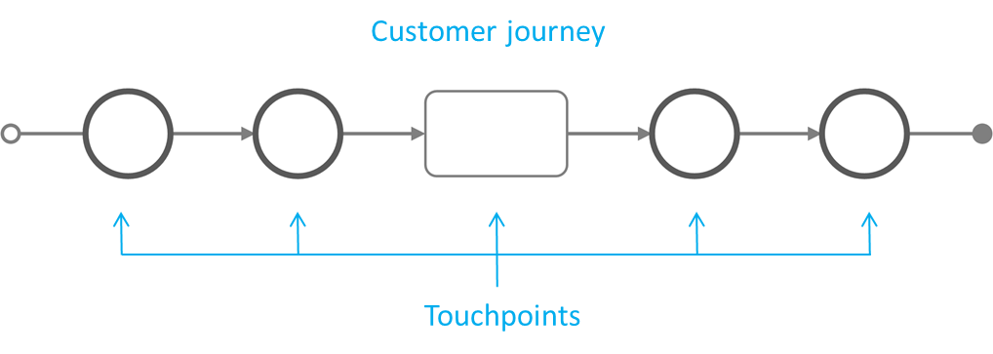
Key facts I
CJML is a formal language for specification and visualization of customer journeys and service processes.
CJML is centred around humans and human activities, regardless of their role being a customer, user, citizen, consumer, patient, or employee.
CJML consists of terminology, diagrams, methods and tools.
The basic concepts of the language are customer journeys and touchpoints.
CJML is a domain specific language for detailed and unambiguous modelling of customer journeys and service processes.
Introducing CJML
Theoretical foundation and modelling approach
A quick tour of CJML
From scenario to journey

Slide 9
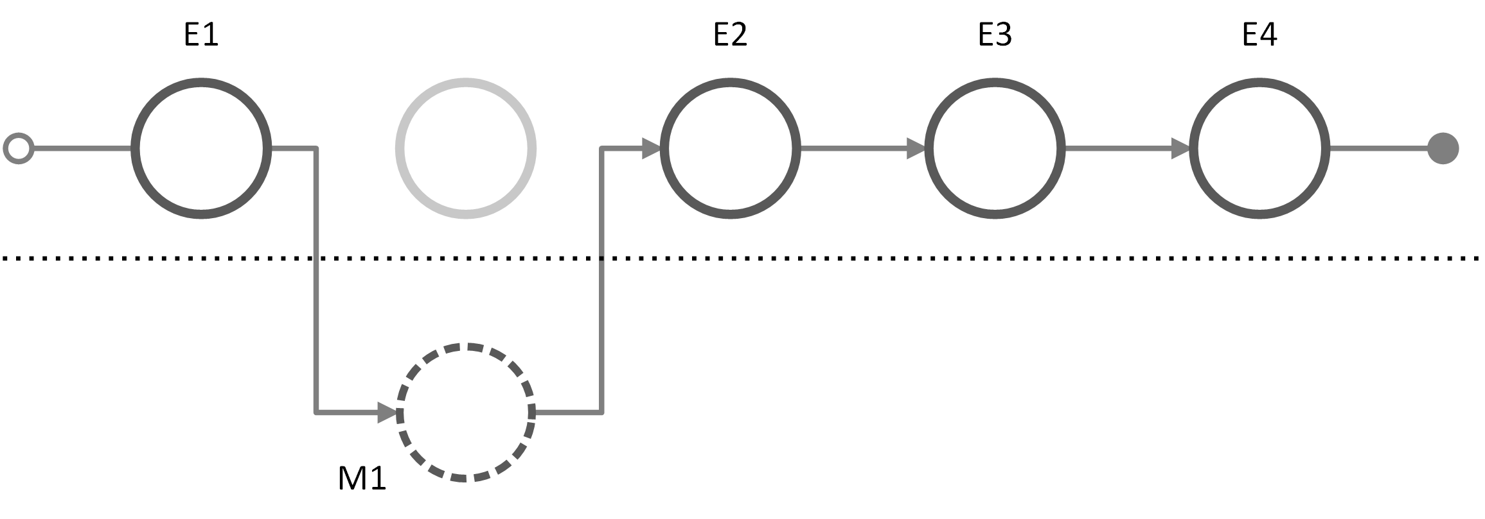
Key facts II
CJML addresses the detailed interactions between
a human and one or more service providers
or a network of users and service providers (C2C, B2C, B2B2C etc)
CJML describes service processes in two states:
The hypothetical state (planned journey)
In a real context (actual journey).
Planned journey
Actual journey
Introducing CJML
Theoretical foundation and modelling approach
A quick tour of CJML
From scenario to journey

Slide 10
Key facts III
CJML differs from other diagrammatic languages in two principal ways:
It models the service process from the customer's point of view
It aims at being intuitive for all users, and does not require a technical background
CJML is well suited for service processes that extends over time and mediated by different communication channels.
CJML is particularly targeting service processes that are technology-driven and repeated in high volumes
Introducing CJML
Theoretical foundation and modelling approach
A quick tour of CJML
From scenario to journey

Slide 11
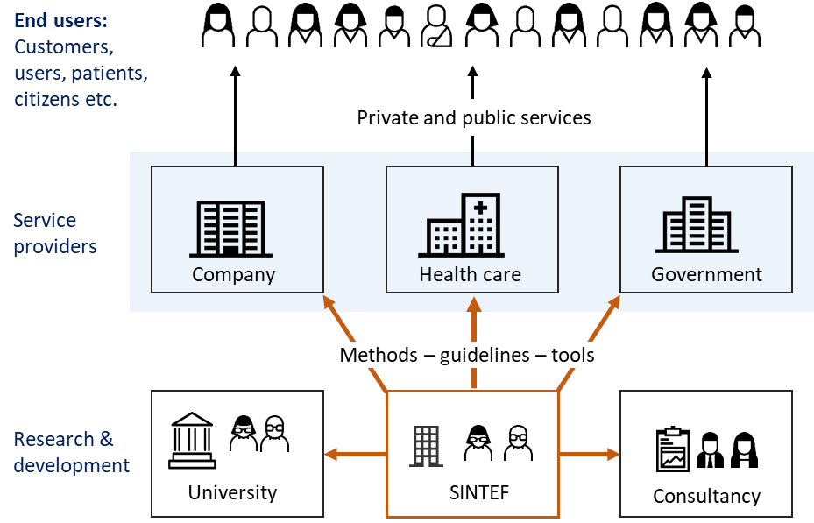
Target group
CJML is relevant for everyone who works in service industries, whether they are engaged in service design, business development or customer support.
The core of CJML targets a wide user group, in principle "everyone" in a service providing organization.
CJML does not require a technical background.
The more advanced features of CJML targets analysts, technologists, and researchers.
Systematic evaluations have shown that new users can adopt CJML quickly and make customer journey diagrams with a high level of precision.
Halvorsrud, R., Haugstveit, I. M., & Pultier, A. (2016). Evaluation of a modelling language for customer journeys. Proceedings from the IEEE Symposium on Visual Languages and Human-Centric Computing, pp. 40-48. IEEE Xplore. doi:10.1109/VLHCC.2016.7739662
Introducing CJML
Theoretical foundation and modelling approach
A quick tour of CJML
From scenario to journey

Slide 12
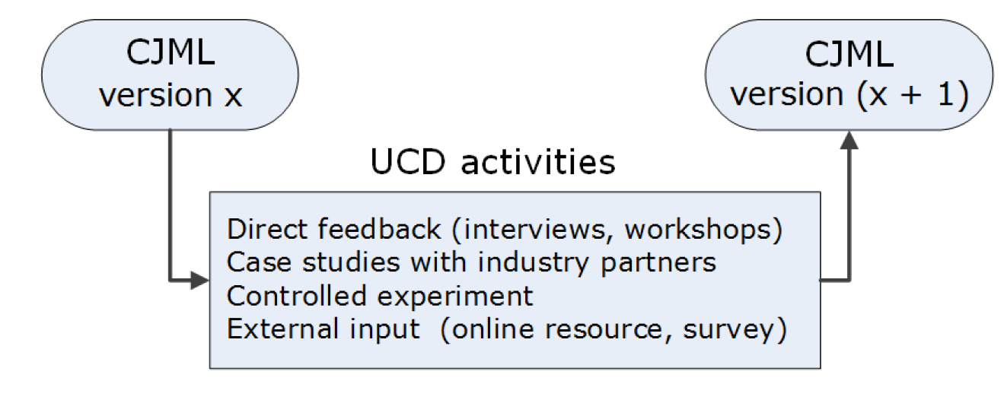
Development and origin
CJML is continuously being development. New and significant upgrades will be available through the research project Smart Journey Mining (2021-2024).
The development of CJML is based on user-centred design (USD)
"User-centred design is an approach to interactive systems development that aims to make systems usable and useful by focusing on the users, their needs and requirements, and by applying human factors, and usability knowledge and techniques."
CJML has been developed in iterations, based on operational experience, literature studies and systematic evaluations:
Case studies with service providers and feedback from target users in the industry
Formal evaluation with target users
Literature studies
External feedback received through surveys, web pages, and peer-review
Development process
ISO. (2019). Ergonomics of human–system interaction — Part 210: Human-centred design for interactive systems. International Organization for Standardization, second edition.
The early versions of CJML was called VISUAL, named after the innovation project from 2013-2016. The VISUAL project was funded by the Research council of Norway, and more information about the partners can be found at www.visualproject.org. CJML has been further developed after 2016 through several SINTEF-led innovation and research projects.

Slide 13
Theoretical foundation and modelling approach
Planned and actual journeys
Journey types and examples
Touchpoint typology
Delineation of steps

Slide 14
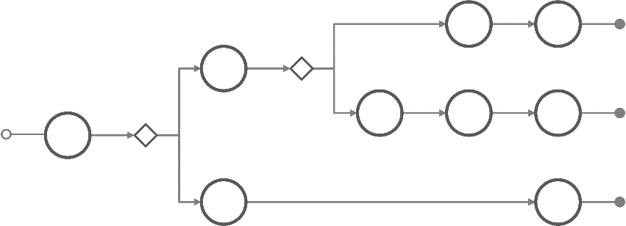
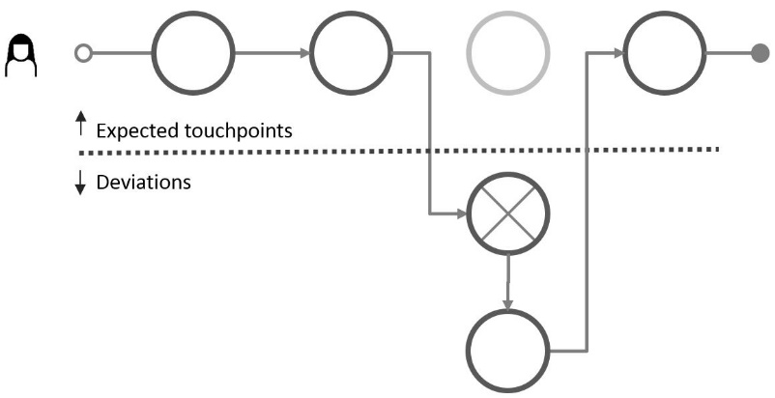
Two states of a service process
The planned service process
The actual service process
can be described and modelled
as implemented by the service provider - regardless of whether it was deliberately designed or resulting from an ad-hoc development process
Often branch into sub-journeys according to conditions, e.g. choice of alternative communication channel
always involve an end user and results in an individual experience
may deviate from the planned service process
results in an experience which is subjective, context dependent, and may change over time
plan
deviation
Theory
Reality
Introducing CJML
Theoretical foundation and modelling approach
A quick tour of CJML
From scenario to journey

Slide 15
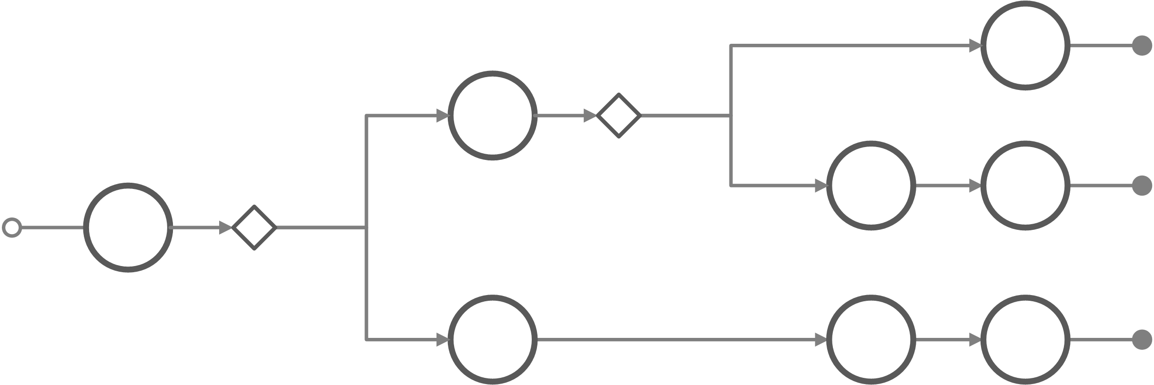
The three types of customer journeys
The planned and actual service processes are modelled as planned and actual customer journeys, respectively. The generic journeys are the collection of alternative paths of the service process.
Generic customer journey (theory) This is the set of planned customer journeys that represents the service. Due to decision points and conditions, the service process often branch into sub-journeys. These sub-journeys represent alternative routes in the service process.
Planned customer journey (theory) A specific customer journey as intended by the service provider, given the service conditions
Actual customer journey (reality) The customer journey as experienced in real life for an individual customer during execution of the service process. The example shows several deviations.
Introducing CJML
Theoretical foundation and modelling approach
A quick tour of CJML
From scenario to journey

Slide 16
Customer journey
Note that CJML can be used for all types of journeys: user journeys, patient journeys, employee journeys etc.
A journey is modelled as a sequence of touchpoints involved for a human user to achieve a specific goal.
The scope of a journey should be defined in relation to the purpose of the study
Communication points are instances of communication or interaction between a user and a service provider
Actions are non-communicative events or activities conducted by an actor as part of a customer journey
Introducing CJML
Theoretical foundation and modelling approach
A quick tour of CJML
From scenario to journey

Slide 17
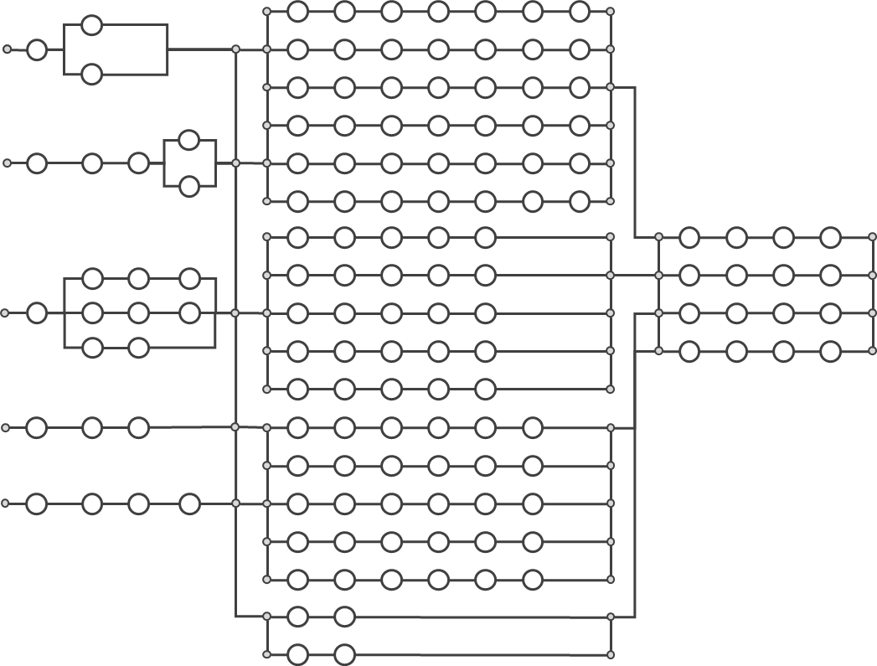
Example – generic journeys for on-boarding customers
A utility company offers five different ways to initiate the on-boarding of new customers.
The numerous choices of communication channels and messages results in as many as N = 648 unique, alternative paths (generic journeys)
Each circle represents a touchpoint (in this case a communication point) where the company and customer communicate through e.g. e-mail, SMS, or an app.
1
2
3
4
All the digital touchpoints leave traces and involves internal systems and work processes.
5
Number of journeys =
9 x 18 x 4 = 648

Slide 18
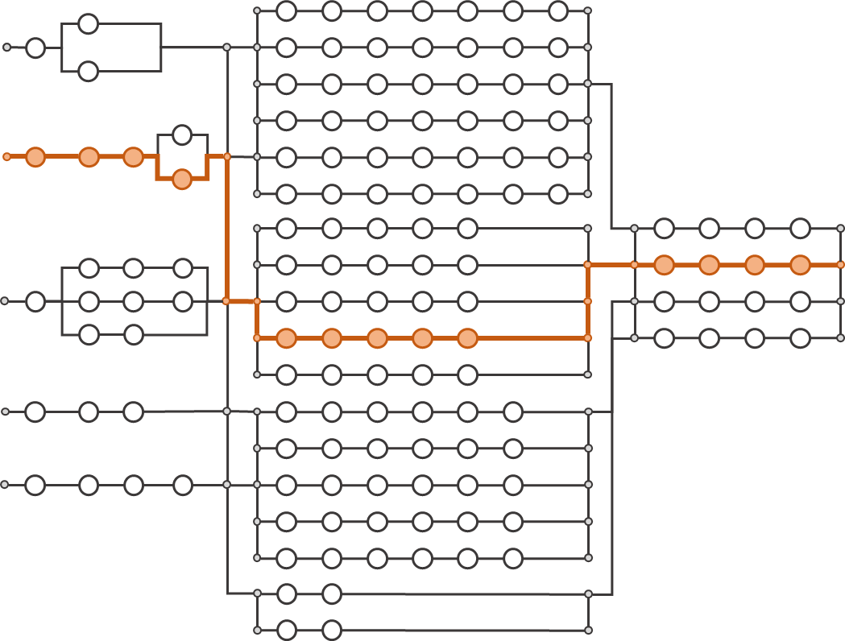
Example – actual journey
Peter is a new customer who choose to sign up through the company web page. His journey is outlined in orange colour.
1
Peter has a unique experience throughout the actual journey
2
I prefer to contact them through their web site.
This was definitely not that easy…
3
4
The customer has completed one of the 648 possible paths.
The journey consisted of 13 touchpoints.
In reality, there are often deviations from the planned journey.
5
Number of journeys =
9 x 18 x 4 = 648

Slide 19
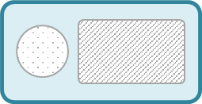
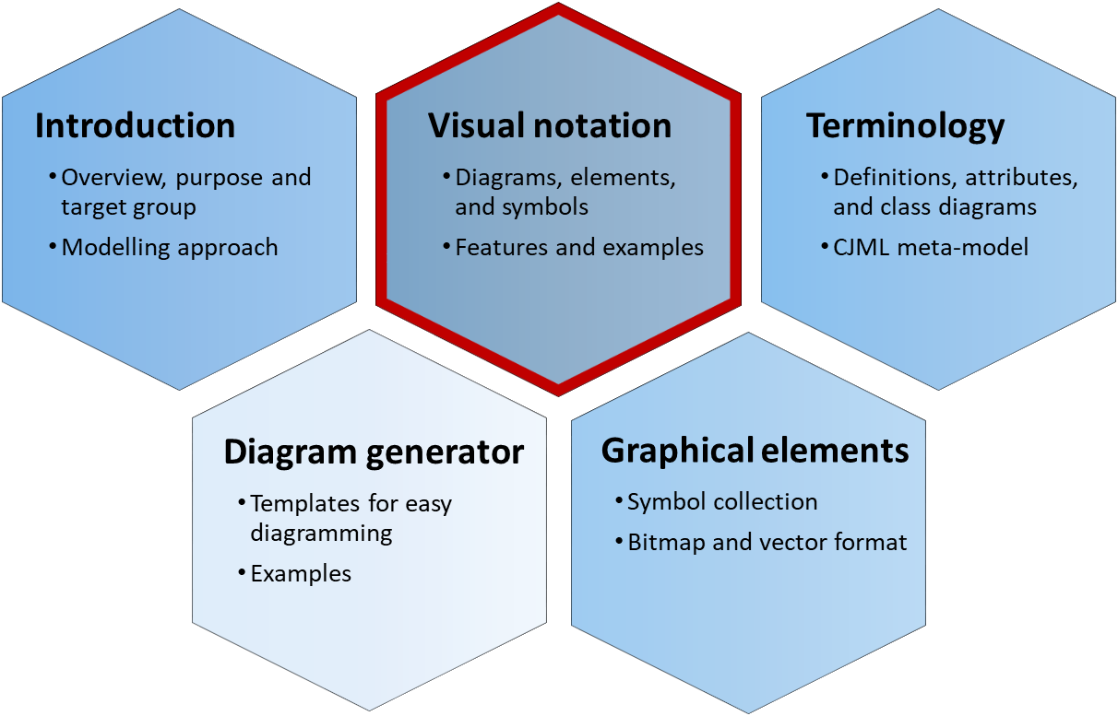
Modelling of communication points
Message
Communication in CJML is defined through the Shannon- Weaver model of linear communication, where a sender transmits a message to a receiver through a communication channel.
This model is pertinent for technology-mediated communication, but clearly has its limitation, e.g. in case of human conversation.
Communication channel
Actor 1
(initiator)
Actor 2
(receiver)
Visual representation of a touchpoint
Shannon, C. E., & Weaver, W. (1963). Mathematical theory of communication. Urbana, IL: University Illinois Press.
Journey diagram
Swimlane/network diagram
Communication channel
Communication channel
There are two ways of modelling a communication point, reflecting the two diagram types in CJML, see the Visual notation document.
text area
Actor 1
(initiator)
Actor 1
(initiator)
direction
Actor2
(receiver)
text area
Useful for simple journeys and for showing deviations from the planned journey.
Useful for journeys with several actors, and for showing both initiator and receiver.
Introducing CJML
Theoretical foundation and modelling approach
A quick tour of CJML
From scenario to journey

Slide 20
What is a customer journey?
Customer journey
A customer journey is defined as a sequence or constellation of touchpoints involved for a customer to achieve a specific goal or a desired outcome. The start and end of the journey must be seen in context with the purpose of the analysis.
As a common method in service design, customer journey mapping is practiced in various ways. However, there are some common factors that can be identified across all approaches:
The journey is based on the customer's point of view
The journey has a time dimension – or a process nature
The journey is divided into steps
Note that a customer journey might involve both voluntary and/or mandatory aspects, and the outcome might or might not be desirable for the customer (e.g. tax reporting resulting in an additional tax payment is an example of a customer journey that is mandatory and with an undesirable outcome).
About customer journeys
The term customer journey is generally used as metaphor for taking a customer's (or a user's, consumer's, citizen's) perspective.
Customer journeys or customer journey mapping also denote a method in service design. The method is often used to express a service user's experience.
Although the method is commonly used in the service industry, it lacks a theoretical foundation and a formalization.
A customer journey is often divided into "before", "during" and "after" the service. Sometimes, the borders between these stages are not can be hard to define.
Examples of journeys
Hospitality service: Going to the cinema to watch a movie. The service process comprises ordering and payment of the ticket, retrieval of the ticket, procedures at the movie theatre, and the movie itself.
Health service: Having a knee surgery. The journey starts with a visit to the general practitioner, and continues with a MR scanning, a consultation with a specialist, and finally the surgery. The patient has a relation to more than one service actor throughout the patient journey.
Introducing CJML
Theoretical foundation and modelling approach
A quick tour of CJML
From scenario to journey

Slide 21
Who are involved in a customer journey?
Directly involved actors The actors on the left side are directly involved in delivering the service to the customer. They are responsible for (parts of) the customer's journey.
External actors The actors on the right side may influence the customer's journey, although they are not responsible for any part of the service delivery.
Example: In the case of a visit to the cinema, a directly involved actor would be the cinema company and the supply chain partner responsible for delivering systems for online booking.
Service provider
Friend
Example: In the case of a visit to the cinema, an external actor could be the newspaper that made the customer aware of the film, or a friend who recommended the film.
Customer
Sub-contractor(s)
Newspaper
Note that a customer often see the set of service providers as one entity, and does not distinguish (or care) about their interrelation.
Introducing CJML
Theoretical foundation and modelling approach
A quick tour of CJML
From scenario to journey

Slide 22
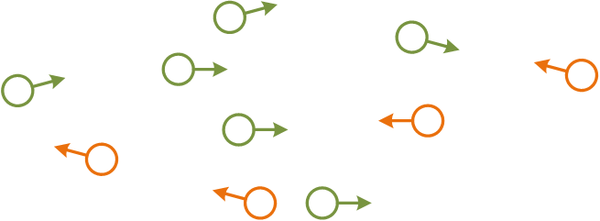
Touchpoints are the "atoms" of a journey
Touchpoint
A customer journey is modelled as sequences of steps that we refer to as touchpoints. Communication points are a sub-class of touchpoints that represents instances of communication or interaction between the customer and other actors. The other sub-class of touchpoints are actions, which do not involve directed communication. Actions are not part of the illustration, but will be further described.
Service provider
Friend
Customer
Sub-contractor
Newspaper
Communication points
Communication points are instances of communication or interaction between the customer and other actors. Communication points forms "the backbone" of a customer journey, and they are associated with
a sender
a receiver
a communication channel
Introducing CJML
Theoretical foundation and modelling approach
A quick tour of CJML
From scenario to journey

Slide 23
Communication points
The Visual notation document contains all the details on how to visualise touchpoints.
Communication points constitutes the backbone of a journey.
The most important attributes are codified in the visual notation.
Both the direction of the communication, and the communication channel itself are visually emphasized.
Communication points initiated by the customer have a different colour than the ones initiated by other actors
Service provider
Friend
Customer
Sub-contractor
Newspaper
The customer sends an e-mail to the service provider
The customer receives an e-mail from the service provider
A friend calls and recommends the movie
Introducing CJML
Theoretical foundation and modelling approach
A quick tour of CJML
From scenario to journey

Slide 24
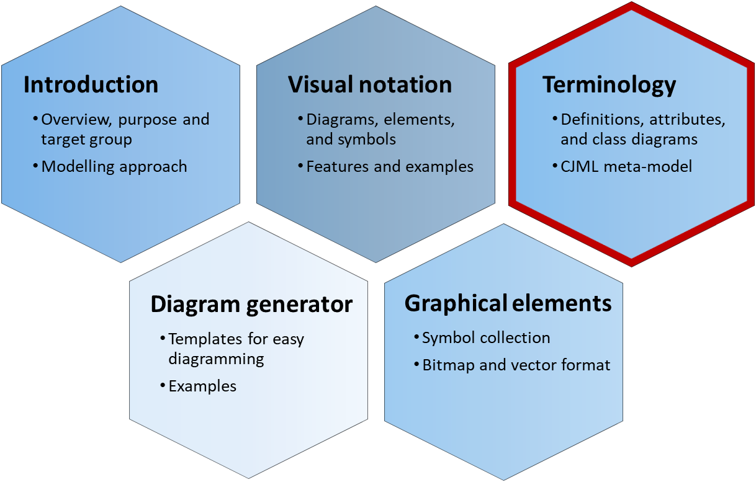
Touchpoint typology
CJML distinguishes four categories of touchpoints
Communication or interaction between the customer and the service provider
Communication or interaction between the customer and an external actor
An action or activity involving the service system
An action or activity not involving the service system.
Touchpoint metamodel
UserJourneyElement
Touchpoint
description: Text
status: TouchpointStatus
arbitrarilyOccuring: Boolean
timeOriginated: Time [0..1]
timeAvailable: Time [0..1]
timeConsumed: Time [0..1]
experienceDescr.: Text [0..1] experienceRating: Note [0..1]
objects
Object
*
backendSyst
ITSystem
0..1
Action
CommunicationPoint
The document describing the terminology provides more information about the attributes of touchpoints.
Introducing CJML
Theoretical foundation and modelling approach
A quick tour of CJML
From scenario to journey

Slide 25
Touchpoint typology
Directly involved actors The actors on the left side are directly involved in delivering the service to the customer. They are responsible for (parts of) the customer's journey.
External actors The actors on the right side may influence the customer's journey, although they are not responsible for any part of the service delivery.
Communication point
External communication point
Direct communication Steps involving a "sender" and a "receiver" in the context of the customer's journey.
A communication channel is always involved.
Communication with the service provider or the service system. Often part of the planned journey.
Communication with an external actor who is not involved in the service provisioning
Action
External action
No communication Steps without communication are called actions. They may or may not involve interaction with the service system.
Non-communicated observations and cognition is included here.
Action involving the service system.
Lisa grabs a shopping cart at the mall
Action not involving the service system.
Lisa writes a shopping list at home
These touchpoints involve the service system, and can be controlled (to some extent) by the service provider.
These touchpoints occur outside the service system, and cannot be controlled by the service provider
Introducing CJML
Theoretical foundation and modelling approach
A quick tour of CJML
From scenario to journey

Slide 26
Extra: Delineation of steps
CJML allows abstraction through journey phases, see the terminology document. Example: before the travel, during the travel, after the travel. More examples can be found in the visual notation document.
All service processes involve a number of steps, and it is not always easy to determine what are individual steps and how the delineation should be.
The general rule is that the process should be divided into touchpoints carrying "the smallest unit of meaningful content" considering the purpose of the mapping.
Another general rule is that when the communication channel change, a new step begins.
The description of a step is always a simplification. To illustrate this, when making a pone call there is a number of steps that are not necessary to describe, e.g. "holding the phone to the ear".
Delineation of steps must always be seen in relation to relevance. The steps "dialling the telephone number" is usually not important to include. But in a process map for emergency routines, this step might be essential.
Example of division: Online shopping can be divided as follows:
Browse the products and assortment
Add product to shopping cart
Look through the order and pay
Example of delineation: A visit to the doctor includes many actions.
Steps that are essential:
The doctor's examination of patient
The doctor's decision about further treatment
Steps that may be important:
Register at the reception (some might have systems that notifies the doctor about arrival)
Payment and check-out
The time spent in the waiting room
Steps that are not important:
Leave home and take the bus to the doctor
Hang the jacket in the wardrobe at the doctor's waiting room
Introducing CJML
Theoretical foundation and modelling approach
A quick tour of CJML
From scenario to journey

Slide 27
Extra: Communication point or action?
What communication is, and what it is not, can be difficult to decide if one doesn't have definitions and guidelines to relate to.
Communication, as it is defined in CJML, requires that a sender sends a message directed towards a defined actor in a specific context.
Note that acquisition of information (perception and cognition) is not defined as communication in CJML unless the information is communicated actively to an intended receiver and in the context of a journey.
Example 1: John is reading the electricity meter and writes down the number on a piece of paper.
This step is an action, as John has not yet communicated the number to anyone.
Example 2: John sends the meter reading to the utility company through an SMS.
This step is definitely a communication point, as the message is actively sent to an intended receiver.
Example of touchpoints that involve direct communication:
A patient has a telephone conversation with the doctor.
The doctor receives an epicrisis from the specialist.
A patient receives a SMS reminder about the upcoming appointment with the doctor.
Example of touchpoints that are not defined as direct communication:
Writing down questions before a visit to the doctor.
Reading an information brochure at the doctor's waiting room.
Looking at the map of the hospital area to find the right building.
Introducing CJML
Theoretical foundation and modelling approach
A quick tour of CJML
From scenario to journey

Slide 28
A quick tour of CJML
Only a small selection of the diagrams and visual features in CJML is shown here.
The full specification can be found in the Visual notation document.
Diagram types and examples
Comparison of diagram types
Customer/User experience

Slide 29
Overview - diagram types
The journey diagram has many visual features, however the swimlane diagram enables a better overview of the service delivery network.
Journey diagram
Suitable for planned and actual journeys with few actors involved
Suitable for actual journeys when emphasizing deviations from the planned journey
Swimlane diagram
Suitable when several actors are involved
Suitable for service delivery networks (see reference)
Reveals both the sender and the receiver of each communication point
Tax et al. (2013). The Service Delivery Network (SDN): A Customer-Centric Perspective of the Customer Journey. Journal of Service Research, 16(4), 454-470.
Note the difference in how a communication point is represented in the two diagrams.
Introducing CJML
Theoretical foundation and modelling approach
A quick tour of CJML
From scenario to journey

Slide 30
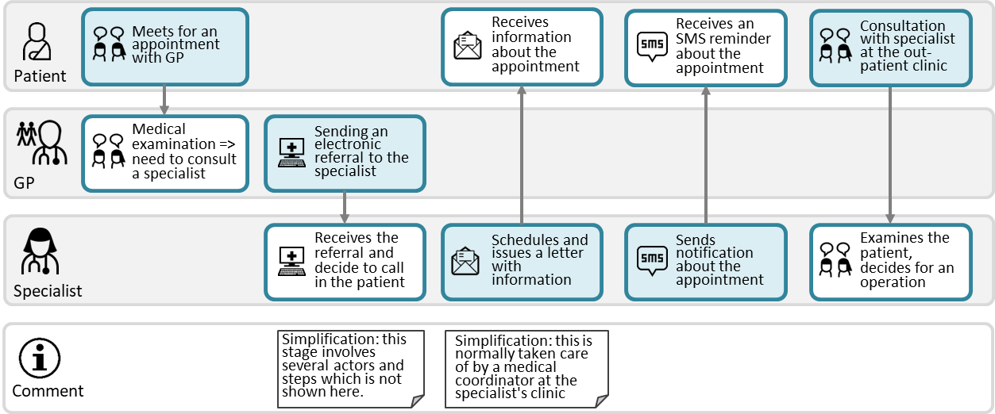
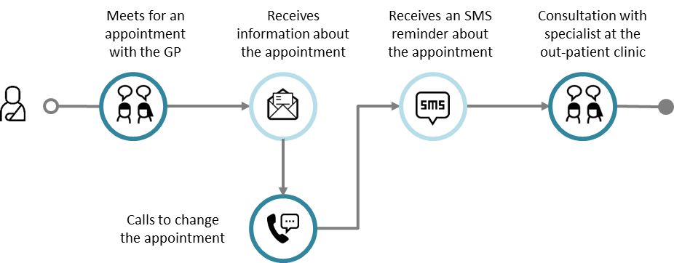
Example: Referral to a specialist
Journey diagram
Example of planned journey
Example of actual journey with a deviation
Swimlane diagram
The patient journey in the upper swimlane corresponds to the planned patient journey to the left
The swimlane diagrams shows all the individual journeys at once, and it also reveals the exchange between the GP and the Specialist, which is not part of the patient journey
Planned journey
Actual journey
This is an example of a deviation from the planned journey
Introducing CJML
Theoretical foundation and modelling approach
A quick tour of CJML
From scenario to journey

Slide 31
Comparison of diagram types
Meets for an appointment with the GP
Receives information about the appointment
Receives an SMS reminder about the appointment
Consultation with specialist at the out-patient clinic
Journey diagram (patient's journey)
Note that this journey corresponds to the elements in the patient's swimlane below.
Swimlane diagram
Meets for an appointment with GP
Receives information about the appointment
Receives an SMS reminder about the appointment
Consultation with specialist at the out-patient clinic
Patient
Medical examination => need to consult a specialist
Sending an electronic referral to the specialist
Note that this touchpoint is invisible for the patient (and thus not part of the patient's journey above)
GP
Receives the referral and decide to call in the patient
Schedules and issues a letter with information
Sends notification about the appointment
Examines the patient, decides for an operation
Specialist
Simplification: this stage involves several actors and steps which is not shown here.
Simplification: this is normally taken care of by a medical coordinator at the specialist's clinic
Comment
Introducing CJML
Theoretical foundation and modelling approach
A quick tour of CJML
From scenario to journey

Slide 32
Customer/User experience
Introducing CJML
Theoretical foundation and modelling approach
A quick tour of CJML
From scenario to journey

Slide 33
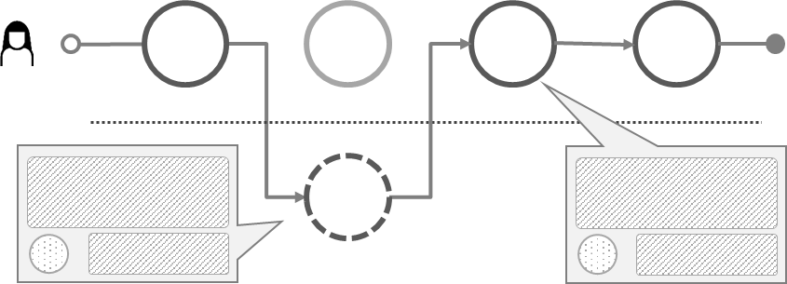
Customer/User experience
CJML insists that a user's experience is individual and thus cannot be assigned to a journey on a general level. In this way, CJML differs from the majority of other customer journey approaches.
When representing user experience (UX), CJML adheres to principles from HCI research;
UX is subjective
UX is dynamic
UX is context dependent
UX is thus associated with actual journeys only.
UX is based on a user's self-reported input.
Otherwise it must be flagged as "anticipated user experience"
UX can be expressed in various ways, depending on the diagram type.
Swimlane diagram: in a separate swimlane
Journey diagram: as call-outs from a communication point
See for example Law, E. et al. (2009). Understanding, scoping and defining user experience: a survey approach. Proceedings of 27th SIGCHI conference on Human factors in computing systems (pp. 719-728).
Journey diagram
Swimlane diagram
Emoticon based on rating
Text based on user's self-reported input
Text based on user's self-reported input
Emoticon based on rating
Introducing CJML
Theoretical foundation and modelling approach
A quick tour of CJML
From scenario to journey

Slide 34
From scenario to journey
Example - alarm service
From business scenario to planned journey
From user scenario to actual journey

Slide 35
Example – alarm service
This example illustrates the business case of a fictitious company, and how this can be transformed into a planned and actual customer journey.
The security company Safe@home offers installation and maintenance of alarm systems targeting the private market.
The company has invested in a new online shop for self-service.
A marketing campaign will be launched to attract new customers
Striving for a smooth and consistent customer experience, Safe@home has decided to map the planned journey for on-boarding of new customers
Scenario: see next slide
Scope of the journey: from the time a customer places an order through the online shop, throughout installation and until payment of the first invoice.
Introducing CJML
Theoretical foundation and modelling approach
A quick tour of CJML
From scenario to journey

Slide 36
Detailed business scenario
This business scenario is now translated into a planned journey.
The scope of the customer journey is set from a customer places an order through the online shop, throughout installation and until payment of the first invoice.
Immediately after placing the order in the online shop the customer receives an e-mail that confirms the purchase and provides additional information about the process ahead.
A technician from Safe@home will carry out the necessary installation in the customer's home. After about two days the customer will receive an SMS with the date for the technician's home visit.
On the day of installation, the technician will call the customer about 1 hour upon arrival, to ensure that the customer is at home. The installation procedure will normally take less than an hour.
A few days after installation, the customer will receive a letter (old-fashioned mail) from Safe@home with additional information about the alarm system and an invoice for the first quarter of the subscription. It is assumed that the customer pays the invoice within the deadline.
Introducing CJML
Theoretical foundation and modelling approach
A quick tour of CJML
From scenario to journey

Slide 37
User scenario: Tina's journey
Tina is one of the many new customers going through the on-boarding process.
Tina needs a burglar alarm in her home and decides to go for a service offered by Safe@Home Inc. Using her laptop she orders an alarm service from the company's online shop. Everything seems to work fine, and Tina is very satisfied with the online shopping experience. A few minutes later she receives an e-mail confirming the details of the order. She is also informed that a technician will take care of the installation of hardware in her home, and that she will receive an appointment date for the home visit.
A few days later Tina receives an SMS from Safe@Home with the time and date for installation. She finds that the suggested date does not suit her plans, as she will be on a business travel at the time for the home visit. Tina calls the support centre but of reasons unknown the connection is broken. She has to leave for an appointment with a friend, and decides to call back later.
The following day she is able to reach the call centre. A new date is settles for the home visit, and immediately after the telephone conversation she receives a confirming SMS. The following week, on the day of the installation, the technician calls her from his car, telling her he is on his way. The technician installs the alarm system without any problems. After a couple of days, Tina receives a letter containing tips and information. It also includes an invoice concerning the first period. The bill contains elements and accounts that Tina is not able to recognize from the marketing campaign. She therefore sends an e-mail to get an explanation. Tina gets an answer per e-mail during the same evening explaining the details of the invoice. Being a considerate customer, Tina pays the invoice through her internet bank the same evening.
Introducing CJML
Theoretical foundation and modelling approach
A quick tour of CJML
From scenario to journey

Slide 38
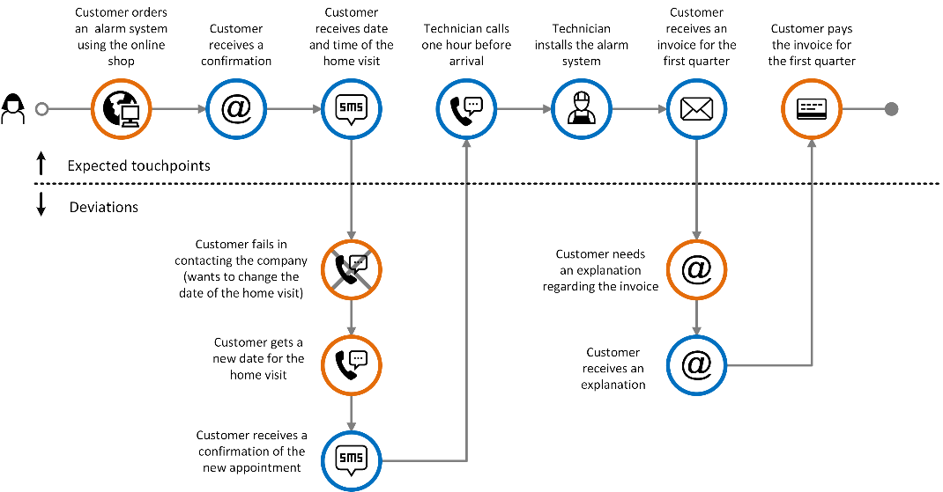
A model of Tina's actual journey
Note how the deviations from the expected journey are represented.
Introducing CJML
Theoretical foundation and modelling approach
A quick tour of CJML
From scenario to journey

